Slide 1


Exploratory Data Analysis:
Facebook User Utilization
Created By: Rahul Gupta Batch : Oct 2021

Slide 2
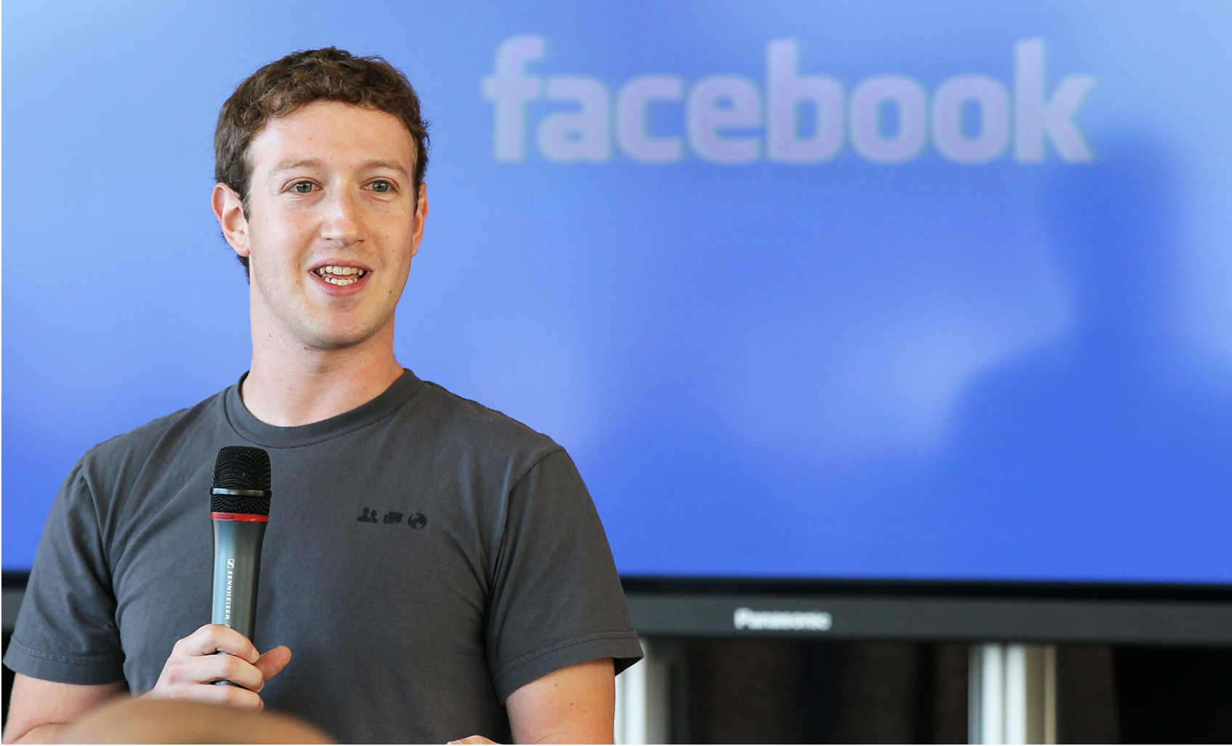
Introduction
Facebook, an American online social networking website where people can create profiles, share information such as photos and quotes about themselves, and respond or link to the information posted by others
Found in 2004 by Mark Zuckerberg along with Eduardo Saverin, Dustin Moskovitz, and Chris Hughes
Facebook became the largest social network in the world, with nearly three billion users and valued $163.52 billion as of 2021
The company’s headquarters are in Menlo Park, California
Access to Facebook is free of charge, and the company earns most of its money from advertisements on the website
In 2006, Facebook opened its membership to anyone over the age of 13
India (349.2 M) followed by United State (193.9 M) are top 2 countries having majority of users as on Oct 2021
Source : https://www.britannica.com/topic/Facebook & Google
Notes:
all of whom were students at Harvard University but Mark Zuckerberg remain the Chairman and Chief Executive Officer

Slide 3
Problem Statement
Study and analyze different pattern using tenure, friend requests, sending likes, mobile vs www likes etc..
Ideas to increase user data base
Maintain user data privacy and prevent scams
New source of investment and revenue generation

Slide 4
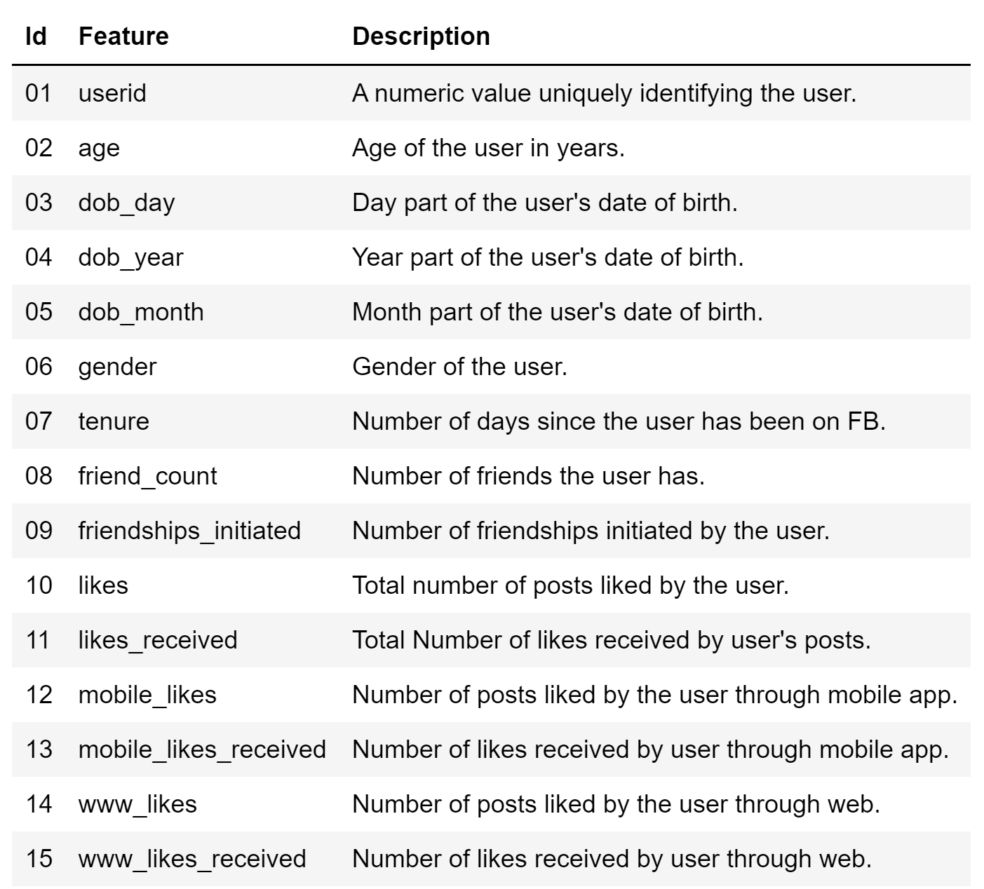
Data Feature & Description
15 Columns | 99,003 Rows
13 feature’s data type is integer, gender and tenure data type is ‘object’ & ‘float’ respectively.

Slide 5
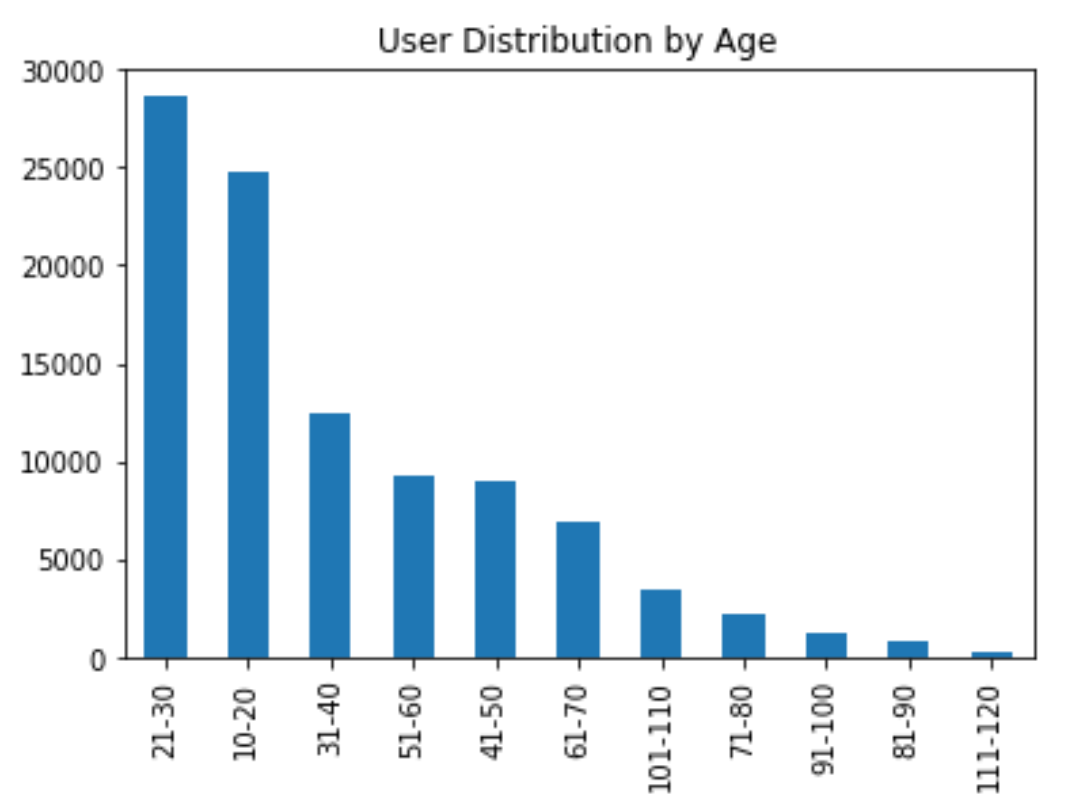
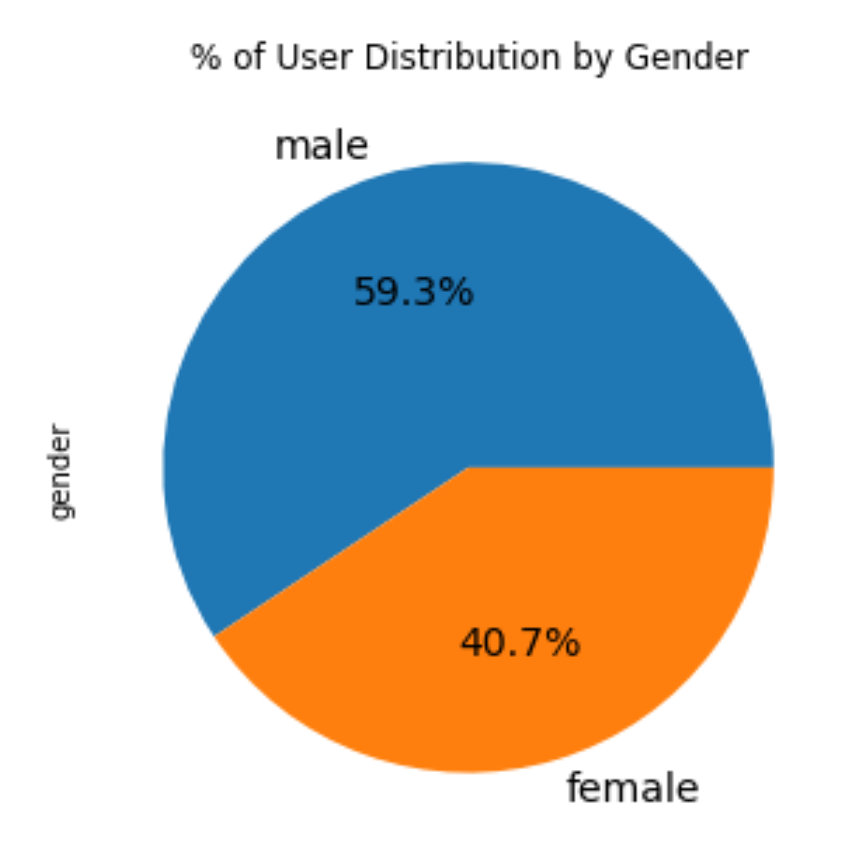
Question# 1 : What age and gender using Facebook more?
21 to 30 age people are more using Facebook which contribute 29% of total user
59.3% is male & 40.7% female
Need some strategy to increase users beyond age group of 30
Verify users beyond age group of 105 which contribute 2%

Slide 6
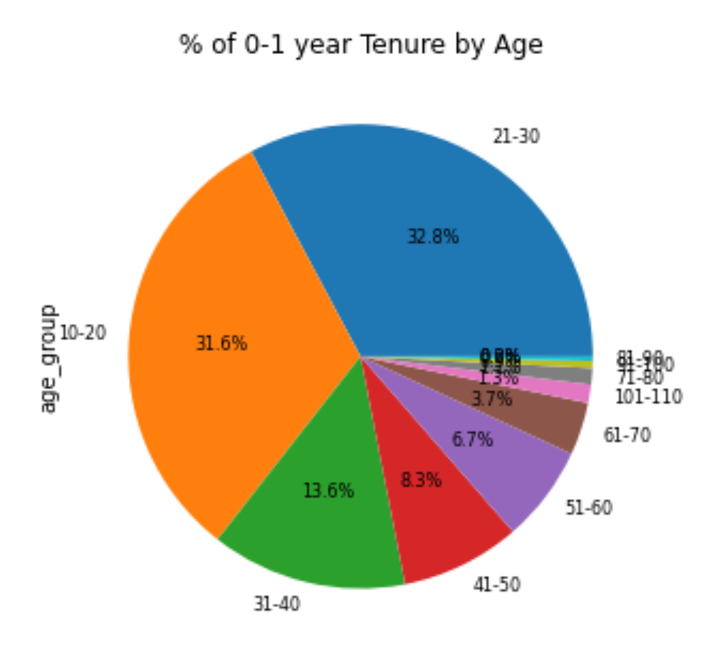
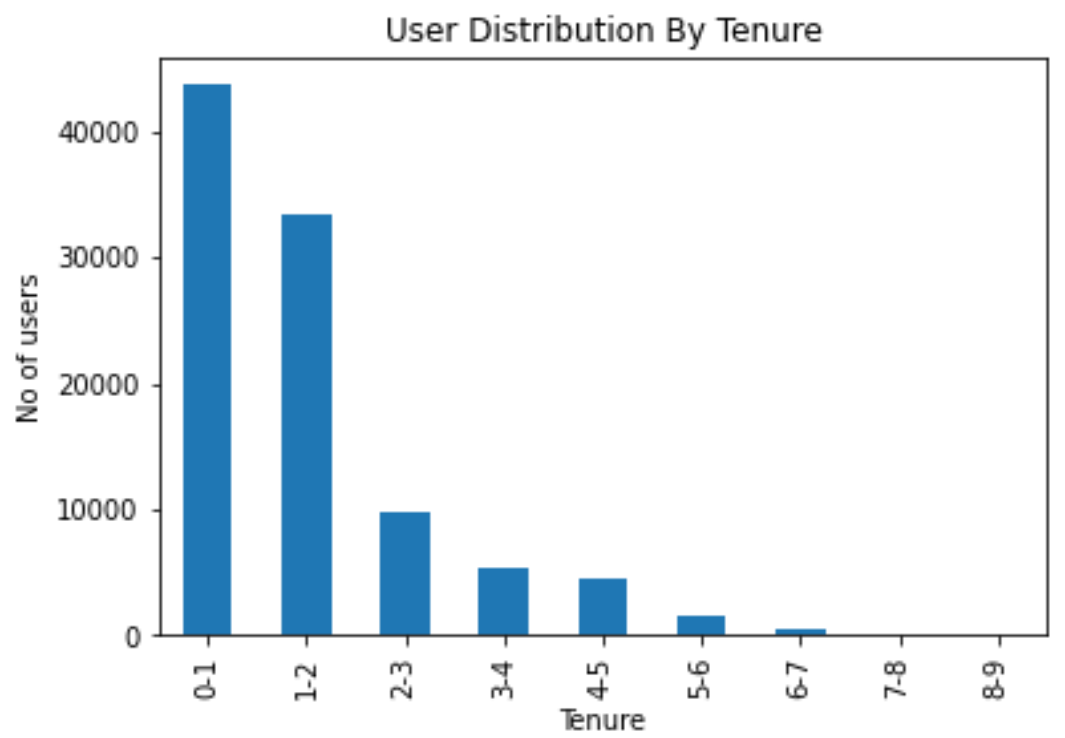
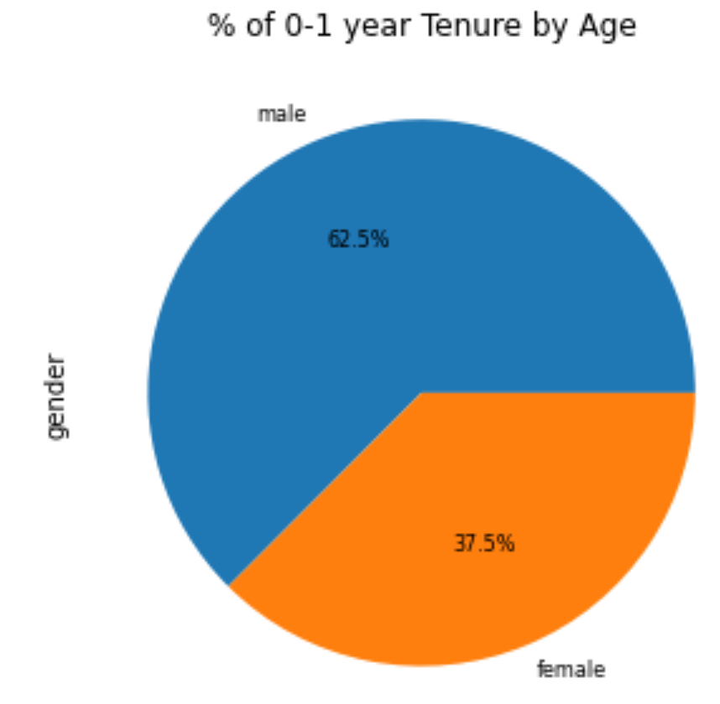
Question# 2 : What is the tenure of users on Facebook?
0 to 1 year tenure users are more on Facebook which is 44% of total users
31.6% of ‘0-1’ year tenure users are from age between 10 to 20 years and male gender users are 63%
Data might be within a year of Facebook opened membership for age +13 year

Slide 7
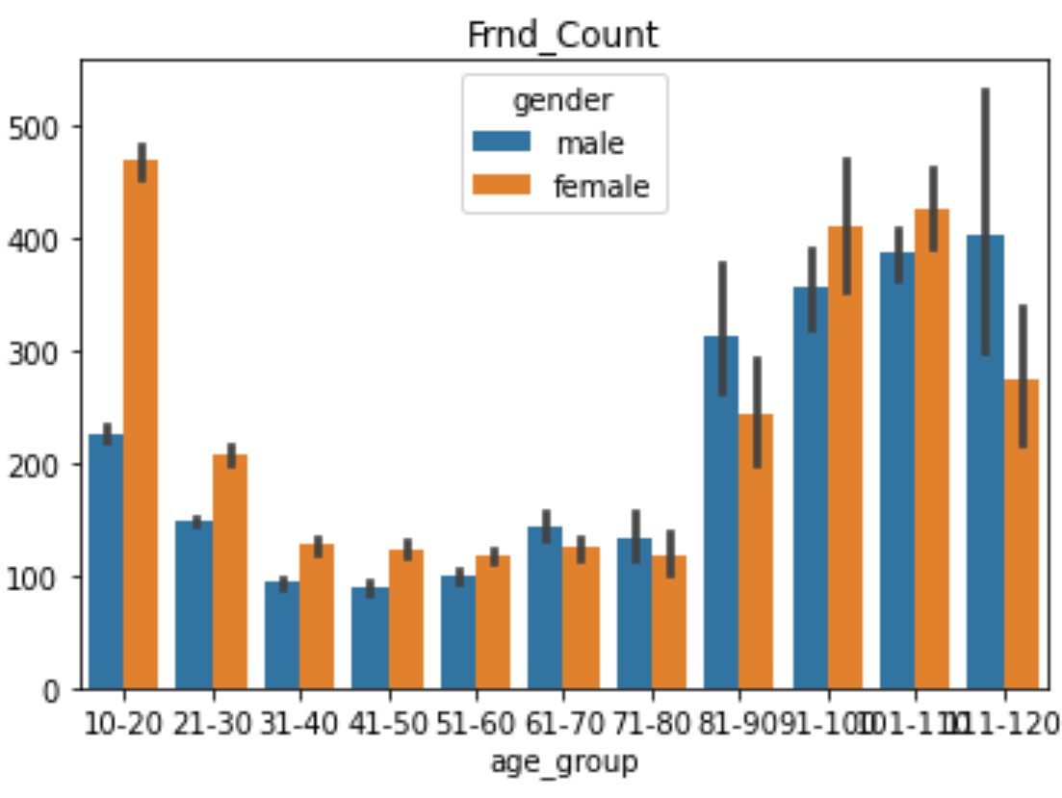
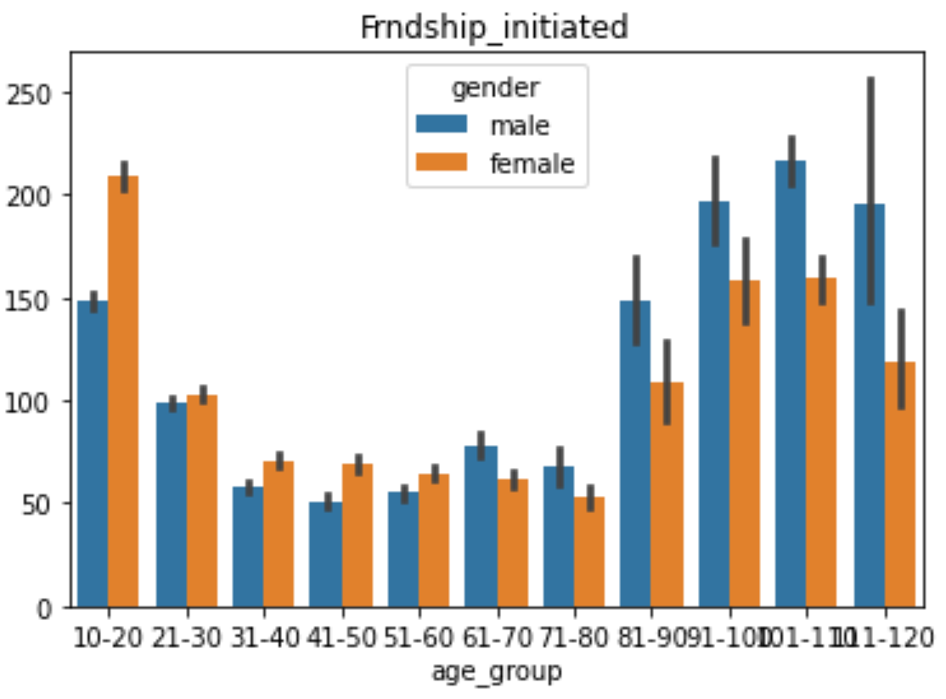
Question# 3 : What gender/tenure have more friends and who initiated more friend request?
Friends Count
Both Male and Female have almost equal number of friends count 50/50
Both young and old female have more friends, whereas older Males have more friend
Friendship Initiated
Male – 57% & Female 43%
Age +61 of Male initiated friendships more
Age between 10 to 60 Female initiated friendship more
(1962 users don’t have any friend and 2997 users never initiated friendship and majority from 0 - 1 year tenure)

Slide 8
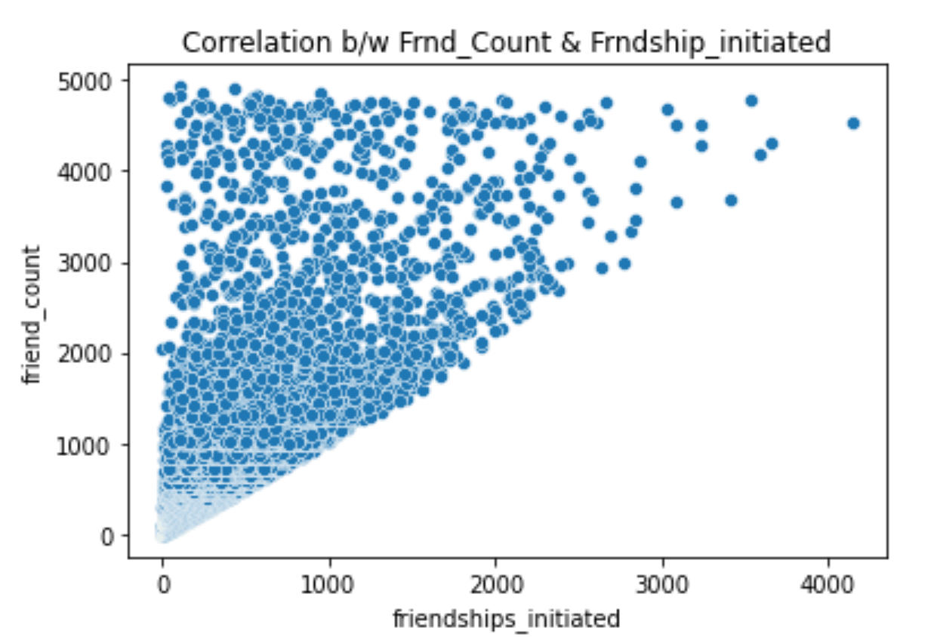
Question# 3 : Continued., correlation between friends count and friendship initiated
Positive correlation
More friendship initiated have more friends count on Facebook

Slide 9
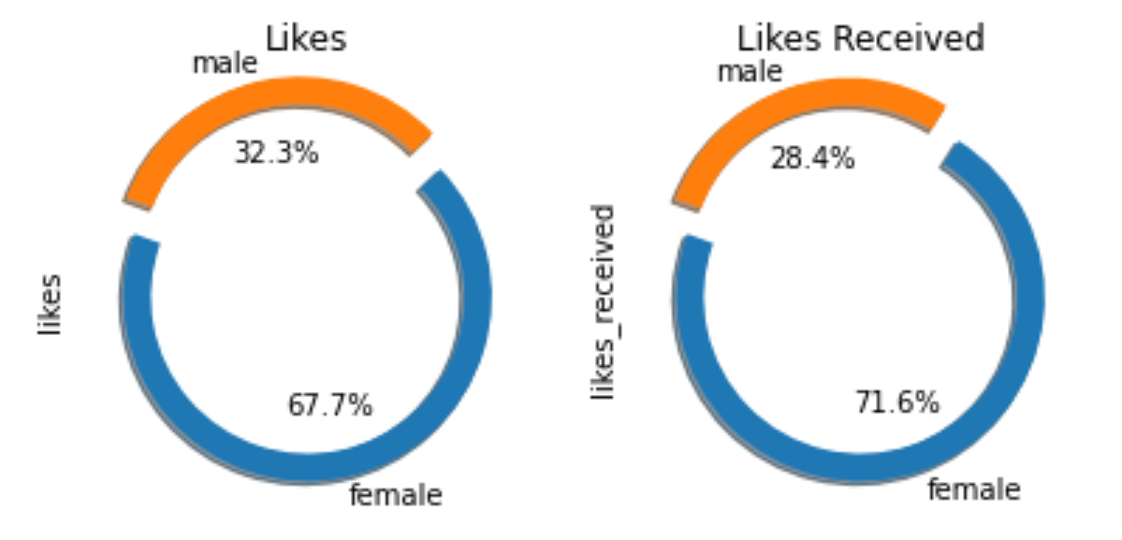
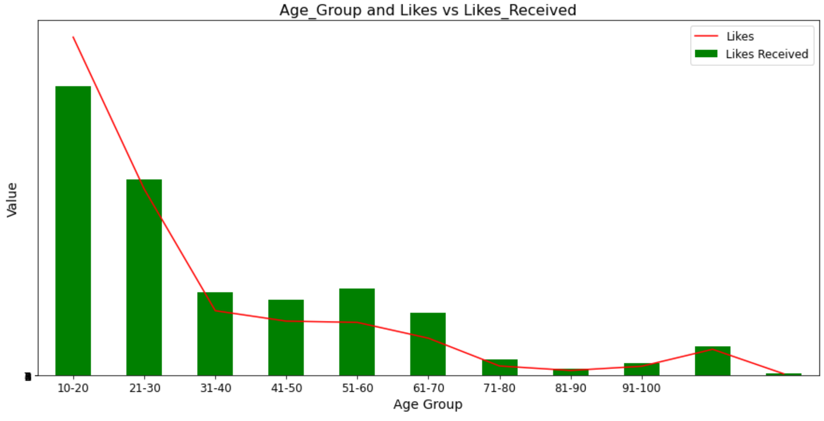

Question# 4 : Which gender provide or receive more likes and on platform mobile/www?
Likes & Likes Received by Gender and Age :
Female gender dominating both for liking other’s post & receiving likes for their own posts on Facebook
10 – 20 age group does more likes than likes received
Rest age group receives like more than they liking other post

Slide 10
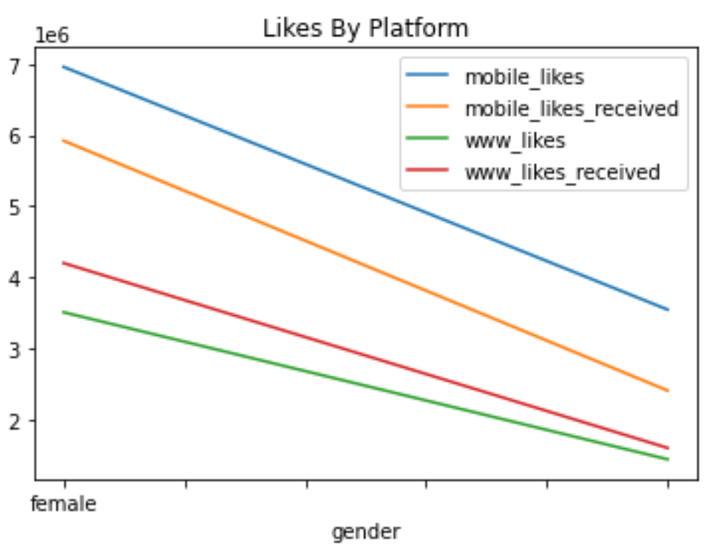
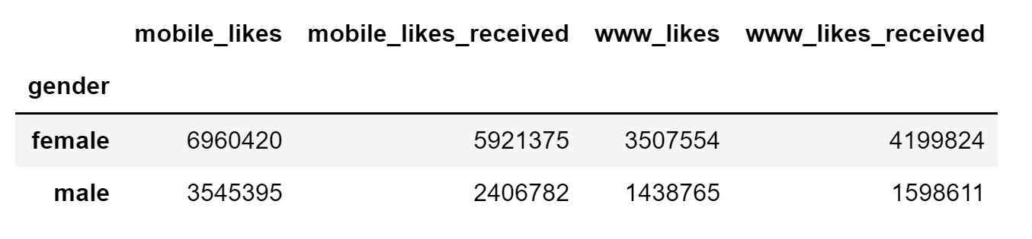
Question# 4 : Continued., likes by platform mobile/www?
Mobiles like and likes received are more compared to www
Female users are more

Slide 11
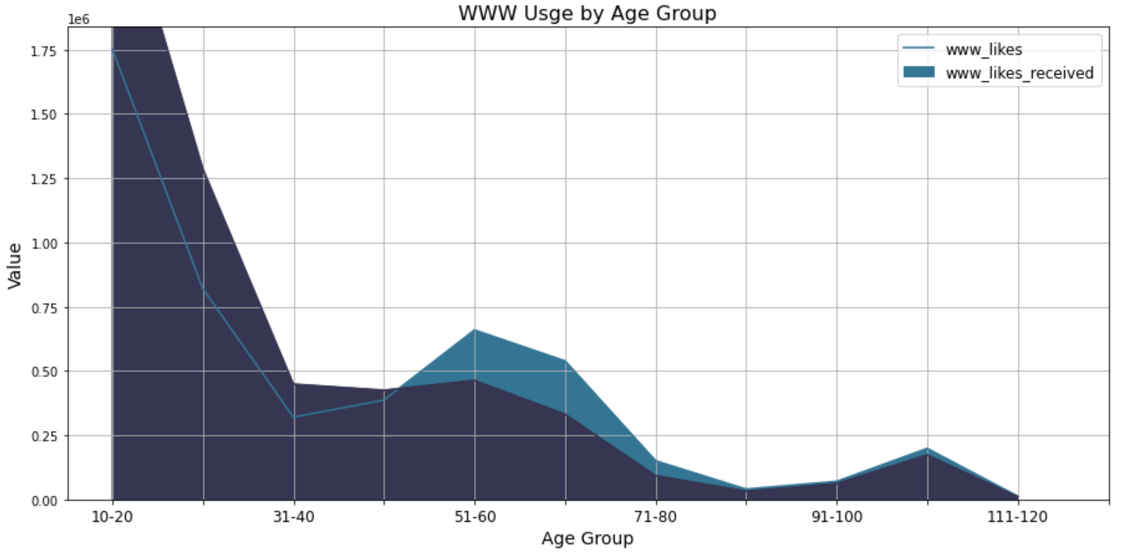
Question# 4 : Continued., user by age group using www platform?
Age group 10 – 20 is using www platform more followed by 50 – 70 age group

Slide 12
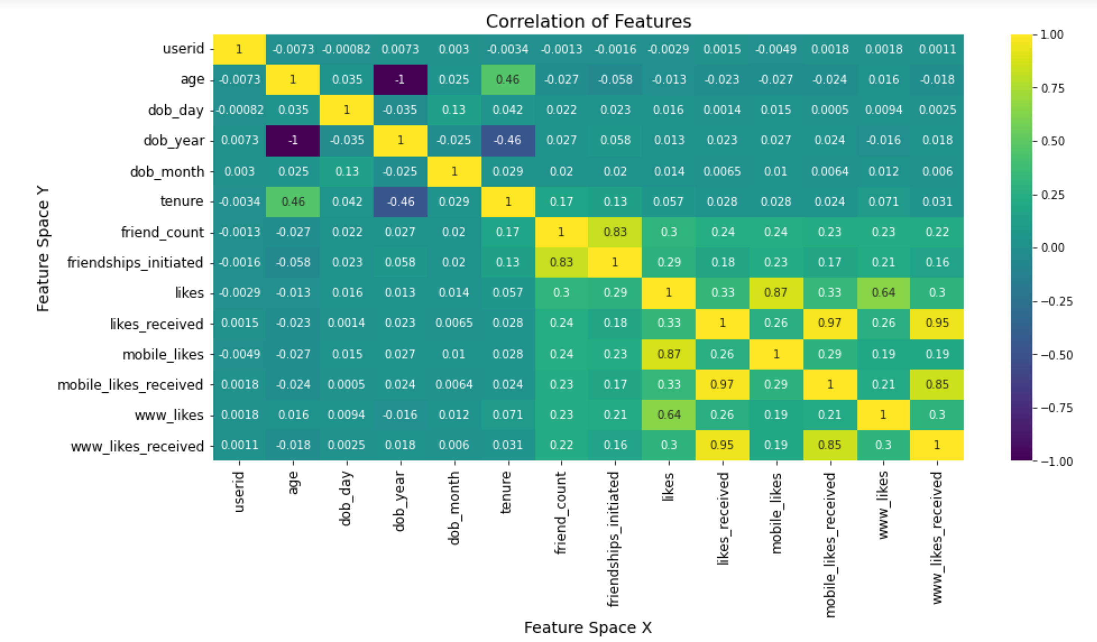
Question# 5 : Correlation Heat Map with all the features of user data
Friendship initiated & friends count
Likes_received & mobile/www likes received

Slide 13
Summary :
Total of 99,001 user data captured - 59.3% are Male & 40.7% are Female – 29% are of 21 – 30 age
Both genders are having equal friend count, whereas Male initiated friendship 14% more than Female. We also noticed positive correlation b/w friendship-initiated vs friends count
41% of FB users are having 0 - 1 year tenure and Male leads with 63%
Female user dominate both likes and likes received by +200% of Male and mostly are +80 age
Usage of FB on mobile is 27% more than www platform
1962 users – Zero Friends, 2997 users – Zero Friendship initiated & 2146 users with +105 age

Slide 14
Actionable Insight :
More career related posts in FB which might help increase user interest from age group 30 to 50. This could also lead for more investment and revenue for FB by involving job agencies
Above feature may also increase activity of Male gender to use FB (Friend count/initiated)
www platform to be more user friendly for the younger generation age (10-20) as the usage is also high and at this age mostly parents prefer not to give them personal mobile.
Spot and avoid possible scam – Inactive users

Slide 15
Thank You

